Slide 1
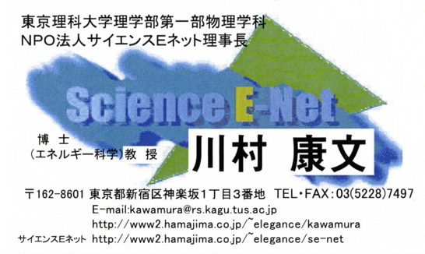
地球環境問題解決
を考える科学実験
Scientific Experiments to Solve Global Environmental Issues

Slide 2
作詞 川村康文
Ｃ Ａｍ Ｆ Ｇ Ｃ Ａｍ Ｆ Ｇ
自転車発電，シャカシャカライト，手回し発電，圧電発電
Ｆ Ｇ Ｃ Ａｍ
さーああ みんなで発電（自転車こいで）
Ｆ Ｇ Ｃ Ａｍ
さーああ みんなで発電（シャカシャカライト）
Ｆ Ｇ Ｃ Ａｍ
さーああ みんなで発電（手回し発電）
Ｆ Ｇ Ｃ Ａｍ
さーああ みんなで発電（圧電発電）
Ｆ Ｇ Ｇ Ｃ
みんなで発電 はじめよう
Ｃ Ａｍ Ｆ Ｇ Ｃ Ａｍ Ｆ Ｇ
自転車発電，シャカシャカライト，手回し発電，圧電発電
Ｃ Ｆ
１．ジュースが飲みたい 冷蔵庫で冷やそう
Ｃ Ｆ
ビールも飲みたい 冷蔵庫で冷やそう
Ｃ Ａｍ Ｆ Ｇ Ｃ Ａｍ Ｆ Ｇ
自転車発電，シャカシャカライト，手回し発電，圧電発電
Ｃ Ｆ
２．ラジオが聞きたい テレビがみたい
Ｃ Ｆ
扇風機より エアコンがほしい
Ｃ Ａｍ Ｆ Ｇ Ｃ Ａｍ Ｆ Ｇ
自転車発電，シャカシャカライト，手回し発電，圧電発電
みんなで発電
A Song for Generating Energy “Minna de Hatsuden”
Ｃ Ｆ
３．大型テレビで ドラマがみたい
Ｃ Ｆ
電子レンジで チンしてご飯
Ｃ Ａｍ Ｆ Ｇ Ｃ Ａｍ Ｆ Ｇ
自転車発電，シャカシャカライト，手回し発電，圧電発電
Ｃ Ｆ
4．ジュースが飲みたい 冷蔵庫で冷やそう
Ｃ Ｆ
ビールも飲みたい 冷蔵庫で冷やそう
Ｃ Ａｍ Ｆ Ｇ Ｃ Ａｍ Ｆ Ｇ
自転車発電，シャカシャカライト，手回し発電，圧電発電
Ｆ Ｇ Ｃ Ａｍ
さーああ みんなで発電（自転車こいで）
Ｆ Ｇ Ｃ Ａｍ
さーああ みんなで発電（シャカシャカライト）
Ｆ Ｇ Ｃ Ａｍ
さーああ みんなで発電（手回し発電）
Ｆ Ｇ Ｃ Ａｍ
さーああ みんなで発電（圧電発電）
Ｆ Ｇ Ｇ Ｃ
みんなが 大好き この地球

Slide 3
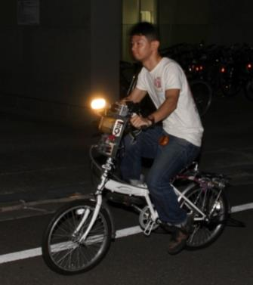
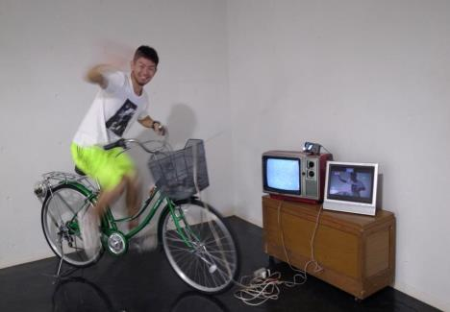

Slide 4
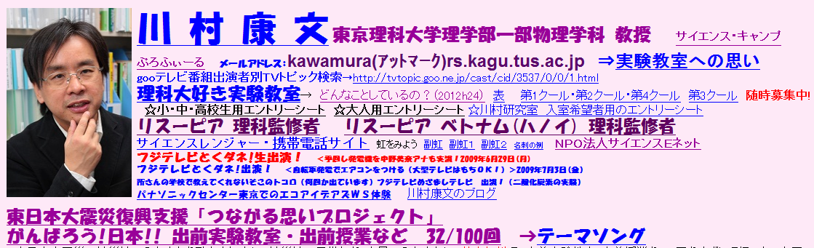
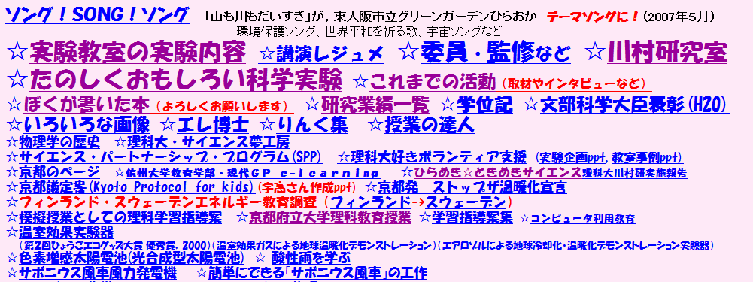

Slide 5
FY 2000 ： “Millennium Project “ - Informatization and Computerization on of Education -
・Proper installment of IT education environment: e.g. computers in elementary, middle and high schools nationwide, Internet , LAN, etc.
・E-Japan Priority Plan :
“Digitalization of educational resources and introducing them into schools “
2002 “Plan to Promote Science &Technology Among Students”（Ministry of Education）
・ It points out recent trend among youth to turn away from science
・Creating of a science and technology-oriented nation
2007 “Science and Technology Human Resources Comprehensive Plan “
・ Enhance science/mathematics education for the next generation who will be responsible for our future

Slide 6
Energy and Environmental Education (2H lecture x 9)
1. Global warming demonstration
2. Dye-sensitized solar cell
3. Wind power using Savonius type windmill
4. Bamboo charcoal battery made from hand-cranked power generator and coffee
5. Energy-saving from one light bulb
6. Watch TV using electric power from bicycle power generator!
7. Recycle 7 (PET bottle fiber)
8. "Spaceship Japan "
9. For the sake of world peace!

Slide 7
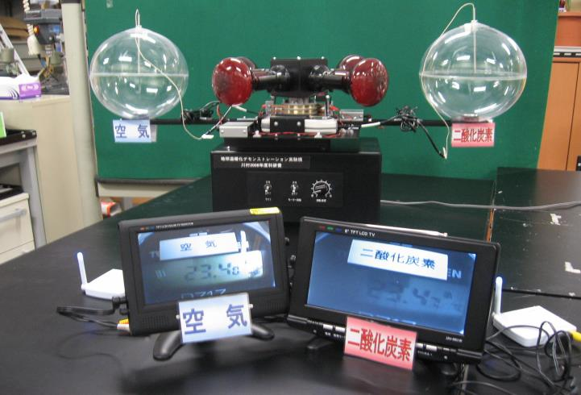
Global Warming Caused by Greenhouse Gases Demonstration Experiment Device
Numerous
TV and media
coverage

Slide 8
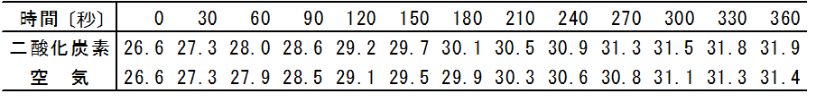
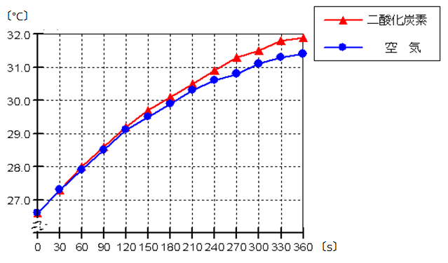
Global warming caused by greenhouse gas
Results of the demonstration experiment device
Time (seconds)
Carbon Dioxide
Air
Carbon Dioxide
Air

Slide 9
Global warming demonstration by greenhouse gas
Comparison of radiation intensity of the earth model in the experimental device
Strength
Wave (nm)
Gray: Infrared lamp only
Blue: Normal - air
Red: Fill with carbon dioxide

Slide 10
Comparison of Radiation Intensity Using a Flask Instead of the Earth Model
strength
Wave (nm)
Gray: Infrared lamp only
Blue: Normal - air
Red: Fill with carbon dioxide

Slide 11
Energy and Environmental Education (2H lecture x 9)
1. Global warming demonstration
2. Dye-sensitized solar cell
3. Wind power using Savonius type windmill
4. Bamboo charcoal battery made from hand-cranked power generator and coffee
5. Energy-saving from one light bulb
6. Watch TV using electric power from bicycle power generator!
7. Recycle 7 (PET bottle fiber)
8. "Spaceship Japan "
9. For the sake of world peace!

Slide 12
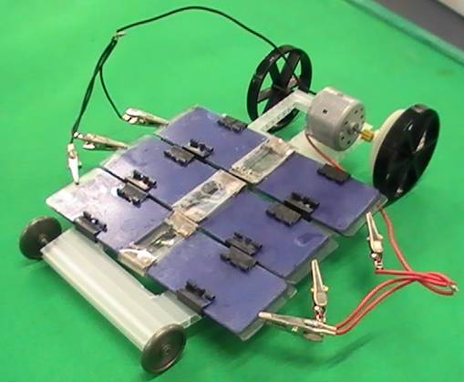
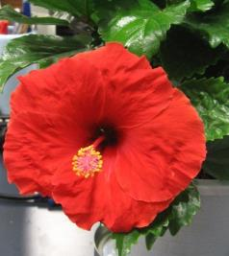
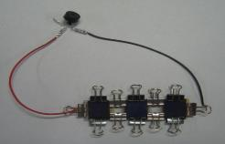
Model car which runs on a dye-sensitized solar cell (teaching material)

Slide 13
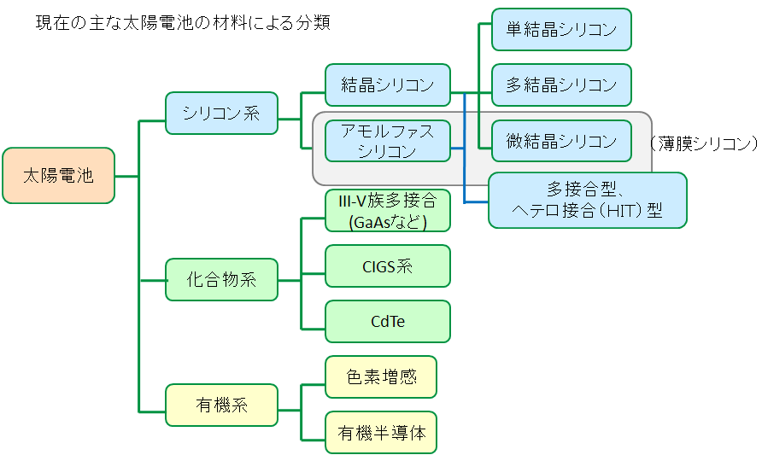
Classification of Solar Cells
Classification of Major Solar Cell Materials
Single-crystal silicon
Crystalline silicon
Polycrystalline silicon
Solar series
Amorphous silicon
Thin-film silicon
III-V Multibinding
Microcrystalline silicon
Solar cell
Multibinding Heterojunction
CIGS system
Compound-based
CdTe
Dye sensitizing
Organic
Organic semiconductor
独立行政法人産業技術総合研究所、「太陽電池の分類」(http://unit.aist.go.jp/rcpvt/ci/about_pv/types/PV-Groups.gif)、2011/11/14確認

Slide 14
Power generation principle of dye-sensitized solar cells
電子
Electron
電流
Current
（－）
（＋）
（正極）
Positive
electrode
ヨウ素電解液
Iodine electrolyte
（負極）
Negative
electrode
－
電気伝導性ガラス
Electrical
conductivity
Glass
ステンレス板
Stainless plate
色素
電気伝導性ガラス
Electrical conductivity
Glass
TiO_{２}
導電膜
Conducting layer
黒鉛または白金
Graphite or platinum

Slide 15
Energy and Environmental Education (2H lecture x 9)
1. Global warming demonstration
2. Dye-sensitized solar cell
3. Wind power using Savonius type windmill
4. Bamboo charcoal battery made from hand-cranked power generator and coffee
5. Energy-saving from one light bulb
6. Watch TV using electric power from bicycle power generator!
7. Recycle 7 (PET bottle fiber)
8. "Spaceship Japan "
9. For the sake of world peace!

Slide 16
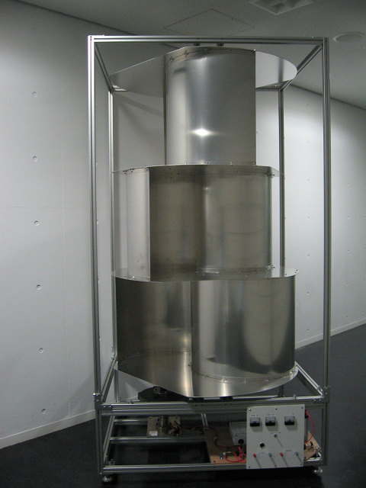
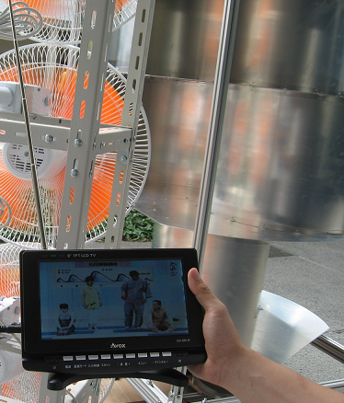
サボニウス型風車風力発電機
Wind Power Generator Utilizing Savonius Type Windmill generator
Even has an attached TV unit!

Slide 17
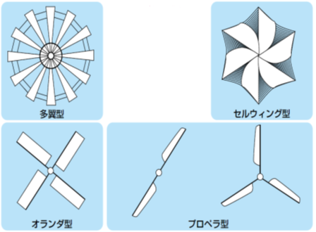
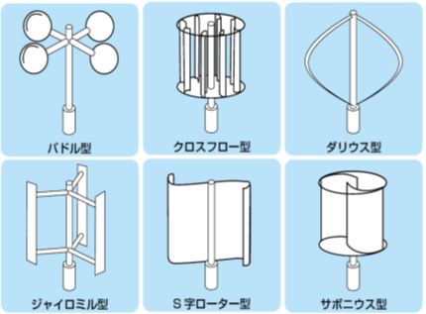
Various Types of Windmills
水平軸風車
Horizontal axis windmill
垂直軸風車
Vertical axis wind turbine
Cross-flow type
Multi-blade type
Cell wing type
Paddle type
Darius type
Propeller type
S-shaped rotor type
Dutch type
Gyro milltype
Savonious type

Slide 18
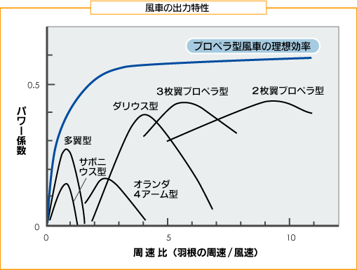
The output characteristics of the wind turbine
Theoretical efficiency of the propeller-type windmill
Three blades propeller type
2-blade propeller type
Power Factor
Darius type
Multi-blade type
Savoniustype
Dutch typetype
Peripheral speed ratio（The peripheral speed of the wing/wind speed）
『風力エネルギーの基礎』 牛山 泉 p.92

Slide 19
What’s a Savonius type windmill?
Part①
paddle
Wind that
rotates paddle
Direction of the wind
bucket
Central axis
Savonius type windmill
Invented by Savonius from Finland.
Cut cylindrical tube vertically into two; install a central axis and shift the left and right to make a windmill
Wind that stops the paddle
Drag-type windmill
Central axis

Slide 20
What’s a Savonius type windmill?
Part②
Central axis
Wind direction that rotates the bucket
バケットを
回転させる向きの風
●Operates without worrying about the direction of the wind
●Less noise
●Bootable in the wind a small amount of
バケットの回転を
止める向きの風
Wind direction that stops the rotation of bucket
Wind that helped to rotate the bucket
It’s a future type of windmill suitable for the urban environment
bucket

Slide 21
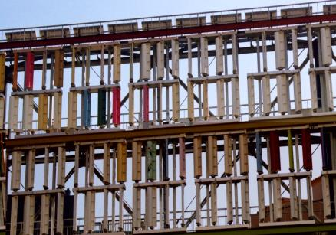
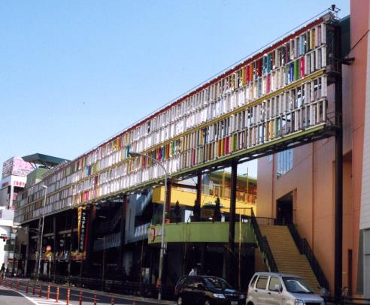
Where is the Savonius Windmill Used?
Solar Panels
Aichi Prefecture Nagoya-shi
Asunal Kanayama
（ Inaba Denki Manufacturing-Built with NEDO Subsidy)
Savonius Type Windmill
Hybrid-type power generation equipment
consisting of Savonius type windmill
and solar cells

Slide 22
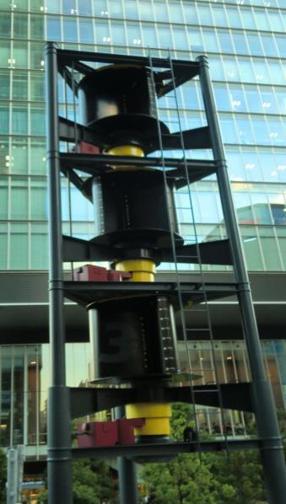
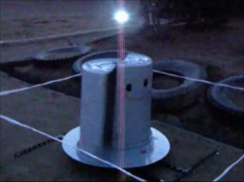
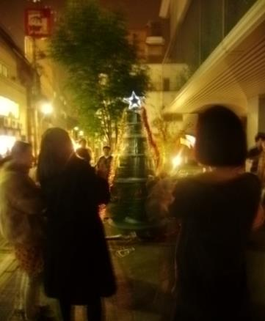

Slide 23
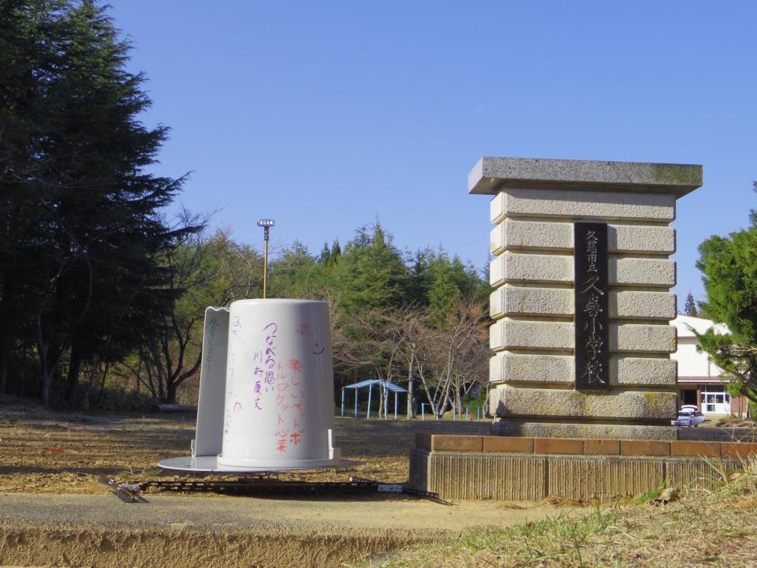

Slide 24
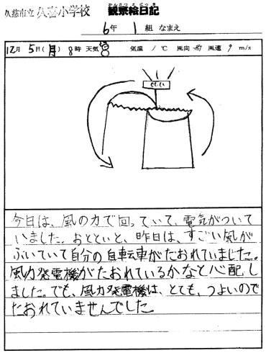
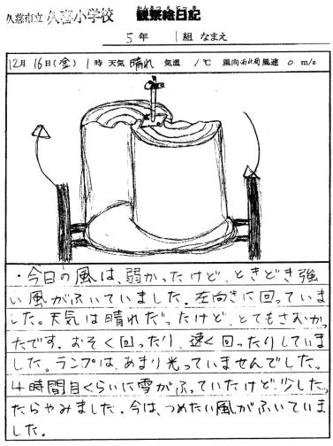
Yesterday it was so windy that my bicycle fell to the ground. I was worried, but the windmill was so strong
it stood there without falling.
Today it wasn’t so windy. The windmill sometimes turns slowly but sometimes turns fast.The lamp was not flickering. A very cold wind is blowing.

Slide 25
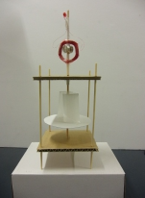
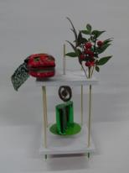
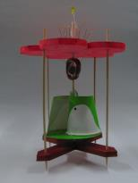
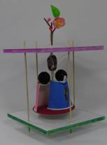
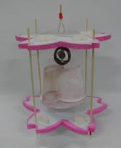
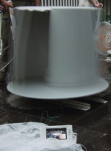
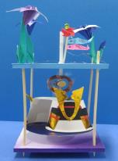
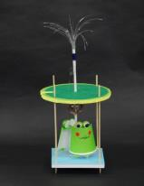
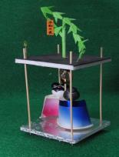
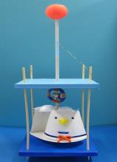
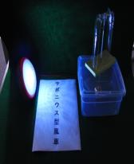
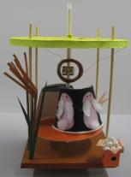
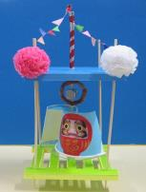
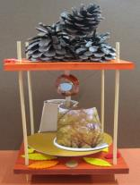
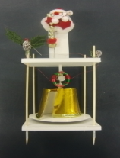

Slide 26
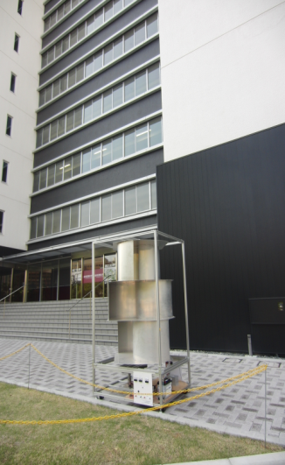
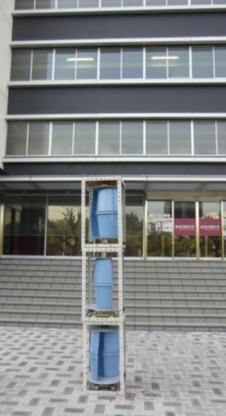

Slide 27
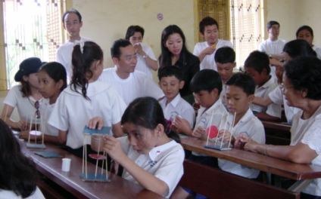
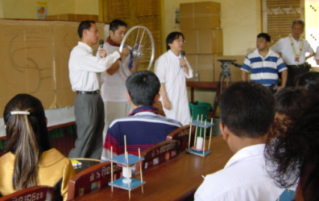
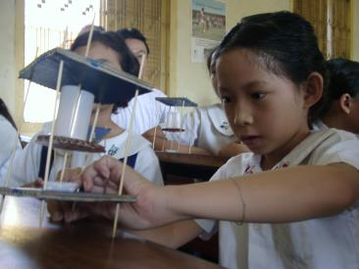
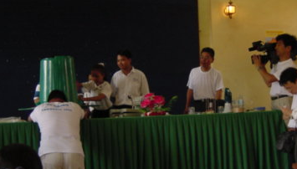
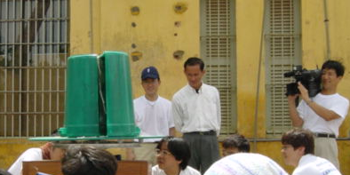
Eco-Science Experiment Class in Cambodia

Slide 28
Energy and Environmental Education (2H lecture x 9)
1. Global warming demonstration
2. Dye-sensitized solar cell
3. Wind power using Savonius type windmill
4. Bamboo charcoal battery made from hand-cranked power generator and coffee
5. Energy-saving from one light bulb
6. Watch TV using electric power from bicycle power generator!
7. Recycle 7 (PET bottle fiber)
8. "Spaceship Japan "
9. For the sake of world peace!

Slide 29
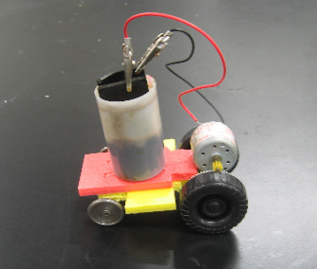
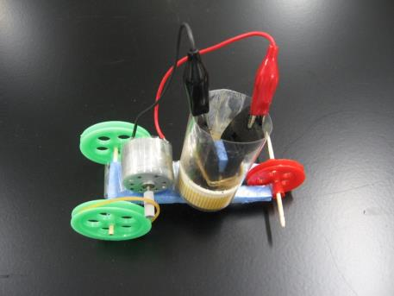
Making bamboo charcoal battery model car using familiar drinks (teaching materials)

Slide 30
Energy and Environmental Education (2H lecture x 9)
1. Global warming demonstration
2. Dye-sensitized solar cell
3. Wind power using Savonius type windmill
4. Bamboo charcoal battery made from hand-cranked power generator and coffee
5. Energy-saving from one light bulb
6. Watch TV using electric power from bicycle power generator!
7. Recycle 7 (PET bottle fiber)
8. "Spaceship Japan "
9. For the sake of world peace!

Slide 31
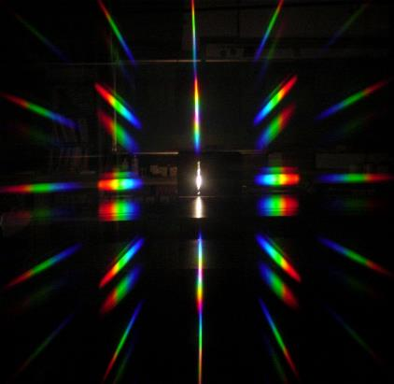


Experimental device for demonstrating energy-saving light bulb

Slide 32

Red
Orange
Green
Blue
Indigo
Purple
Yellow

Slide 33



Light of the sun
Ultraviolet rays
Visible light
Infrared
Black light
Germicidal lamp
Infrared heater
Sunburn
250
350
365
380
770
1000
wavelength $λ〔nm〕$
strength
Light energy
weak

Slide 34








Slide 35



Under white light, it is a pure white sheet,
but when shed with ultraviolet light, the sheet will emit each color of Red Green and Blue.

Slide 36


Year 2005
July 28, 29 days (Thursday & Friday)
World Physics Year 2005
Shin-Etsu Experimental Class
Nagano Prefecture, Sakaemura Village
2014 October 7
Shuji Nakamura Sensei
Nobel Prize in Physics

Slide 37
Energy and Environmental Education (2H lecture x 9)
1. Global warming demonstration
2. Dye-sensitized solar cell
3. Wind power using Savonius type windmill
4. Bamboo charcoal battery made from hand-cranked power generator and coffee
5. Energy-saving from one light bulb
6. Watch TV using electric power from bicycle power generator!
7. Recycle 7 (PET bottle fiber)
8. "Spaceship Japan "
9. For the sake of world peace!

Slide 38


An experiment to experience the energy-saving technology using “bicycle power generator”
A Battle between cathode-ray tube TV vs LCD television

Slide 39
Attaining world peace through “bicycle power generation”
Ms. Wangari Maathai’s slogan "MOTTAINAI"
→ Switch to eco-friendly choice
Experience the evolution of energy-saving technology,
→ Enjoy eco-friendly way of life!
Battle between the new TV and the old cathode-ray tube TV!
Electricity generated from two bicycles can turn on a power a large TV!
Electricity generated from two bicycles can turn on an air conditioner!

Slide 40
Energy and Environmental Education (2H lecture x 9)
1. Global warming demonstration
2. Dye-sensitized solar cell
3. Wind power using Savonius type windmill
4. Bamboo charcoal battery made from hand-cranked power generator and coffee
5. Energy-saving from one light bulb
6. Watch TV using electric power from bicycle power generator!
7. Recycle 7 (PET bottle fiber)
8. "Spaceship Japan "
9. For the sake of world peace!

Slide 41




Creating fiber from PET bottles

Slide 42


Knack for making good PET bottle fiber is to make cotton candy at the beginning.

Slide 43
Recycled Materials: Types of different symbols
Usage
Specific gravity
PET bottle
Polyethylene Terephthalate
Plastic shopping bag
/ bucket
High Density Polyethylene
Pipe hose
Polyvinyl Chloride
Low Density Polyethylene
Wrap film, tube type container
Polypropylene
Food containers and bath goods
Tray Cup
Polystyrene

Slide 44

高校
化学の
授業でも
歌って
もらい
ました

Slide 45


Slide 46
Energy and Environmental Education (2H lecture x 9)
1. Global warming demonstration
2. Dye-sensitized solar cell
3. Wind power using Savonius type windmill
4. Bamboo charcoal battery made from hand-cranked power generator and coffee
5. Energy-saving from one light bulb
6. Watch TV using electric power from bicycle power generator!
7. Recycle 7 (PET bottle fiber)
8. "Spaceship Japan "
9. For the sake of world peace!

Slide 47


Science Live Show : “Spacecraft Japan” tries to protect the earth from “Global Warming Aliens”
１００回公演
をめざす。
日本では初！
Aiming to reach the 100th performance.
One of a kind in Japan!

Slide 48


New ways to show and explain carbon dioxide
→
Global warming
demo experiment

Slide 49
Energy and Environmental Education (2H lecture x 9)
1. Global warming demonstration
2. Dye-sensitized solar cell
3. Wind power using Savonius type windmill
4. Bamboo charcoal battery made from hand-cranked power generator and coffee
5. Energy-saving from one light bulb
6. Watch TV using electric power from bicycle power generator!
7. Recycle 7 (PET bottle fiber)
8. "Spaceship Japan "
9. For the sake of world peace!

Slide 50
Einstein,
Hideki Yukawa Sensei (Nobel laureate),
And you and your friends!
Love the earth and love humanity
Let’s pray for world peace !!

Slide 51


Slide 52


Slide 53
地球環境問題解決
を考える科学実験

Slide 54


Slide 55
Energy and Environmental Education – 9 Lectures (2 hours/lecture)
1. Global warming demonstration
2. Dye-sensitized solar cell
3. Wind power using Savonius type windmill
4. Bamboo charcoal battery made from hand-cranked power generator and coffee
5. Energy-saving from one light bulb
6. Watch TV using electric power from bicycle power generator!
7. Recycle 7 (PET bottle fiber)
8. "Spaceship Japan "
9. For the sake of world peace!

